Slide 1
Welcome to 7th grade Science
Candus Muir

Slide 2
Teaching experience
BS Science and Math; Teaching Certificate
26th year; Starting 17th year at TCA
Texas, England, Germany, Colorado
Elementary, JH, and High School

Slide 3
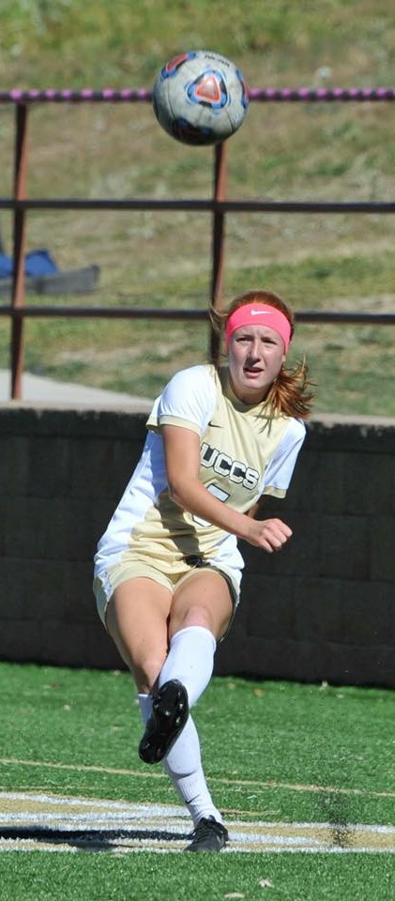
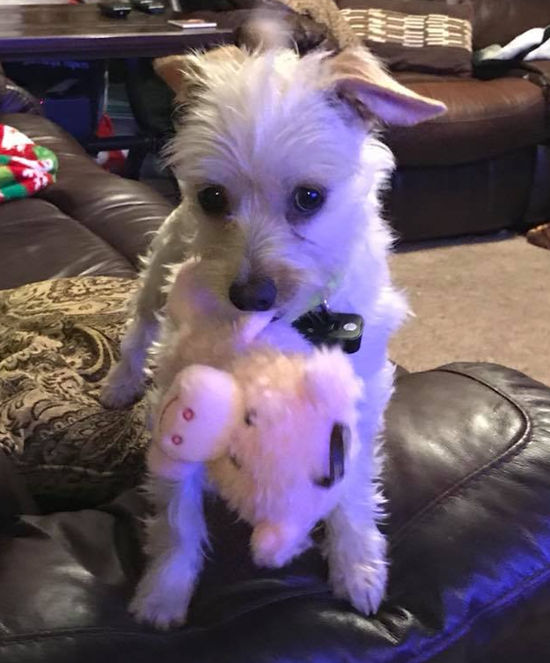
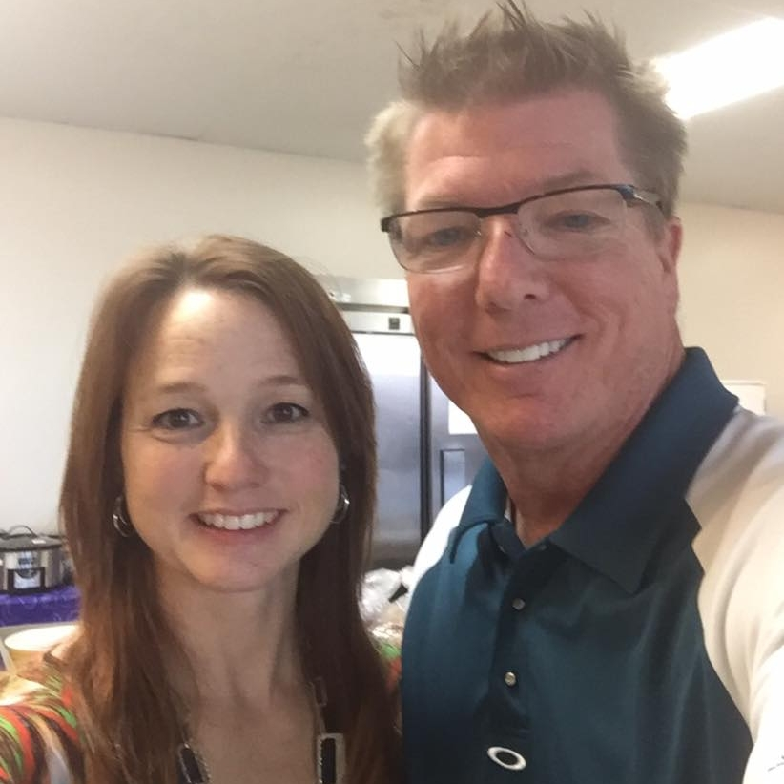
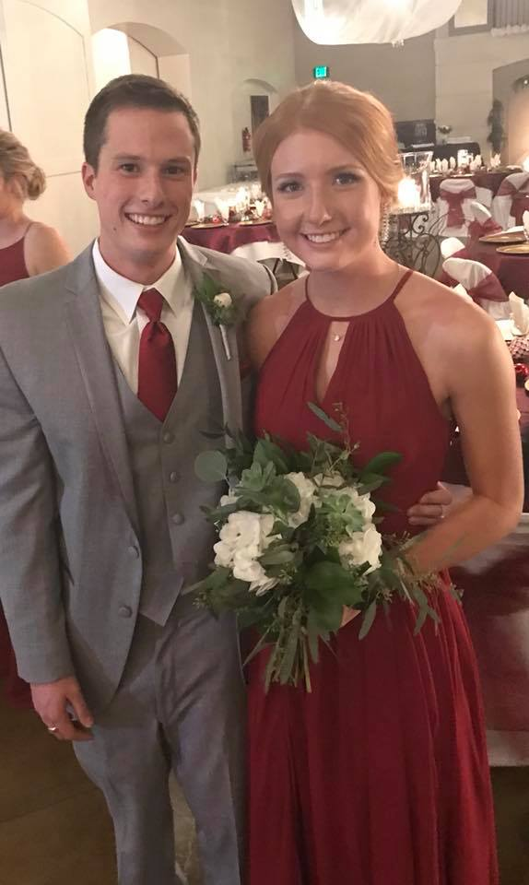
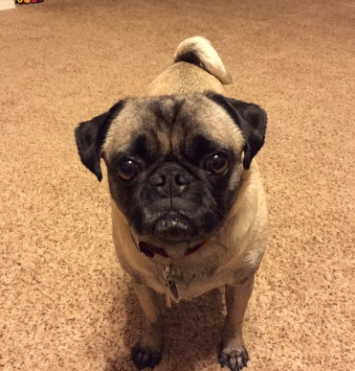
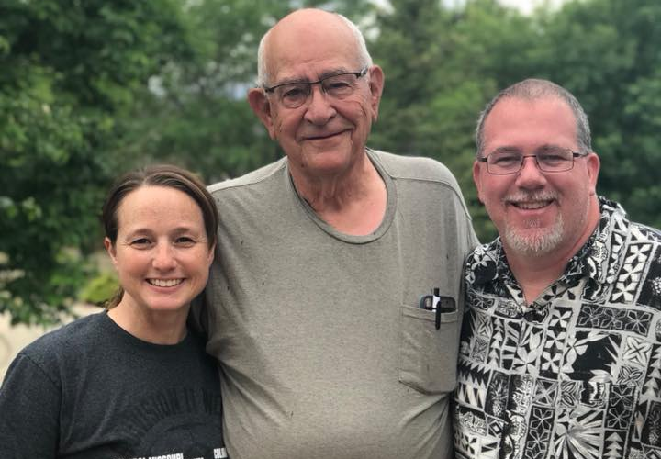
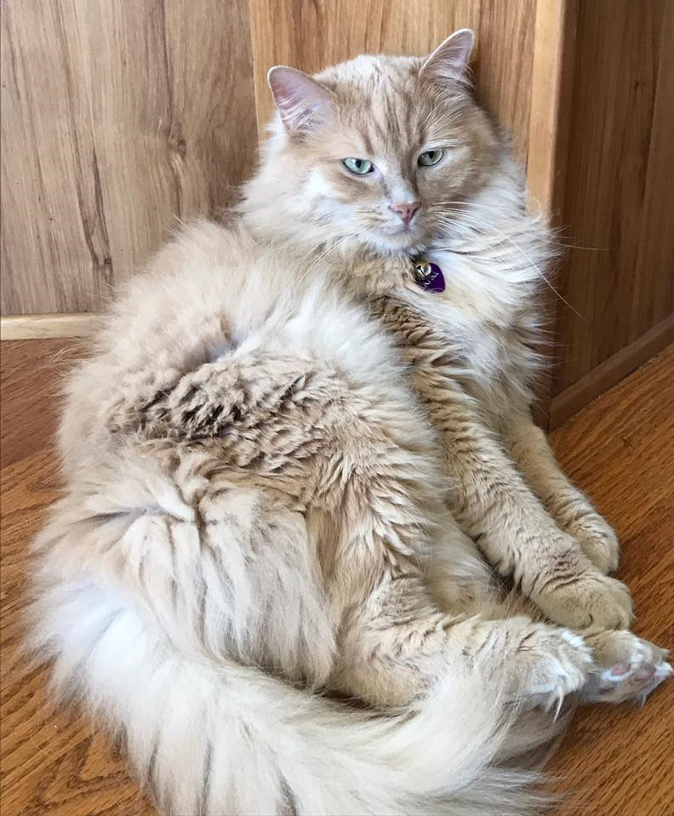
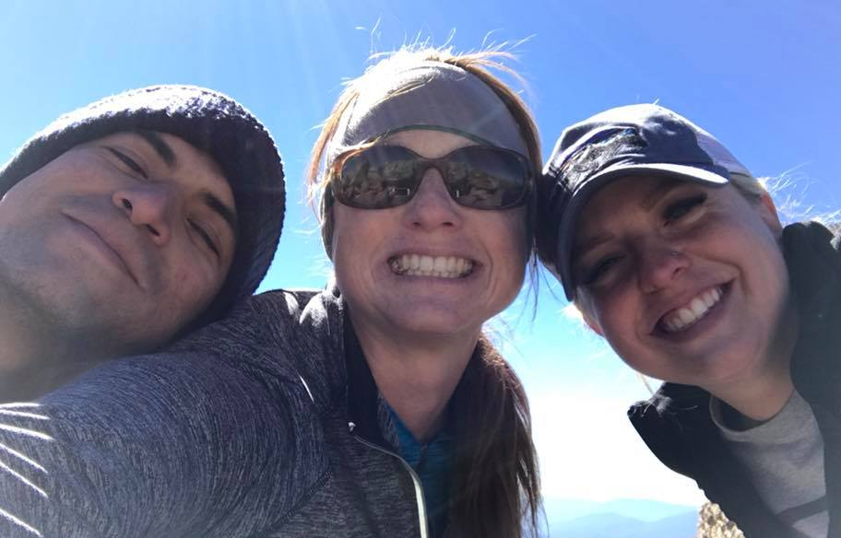
Family

Slide 4
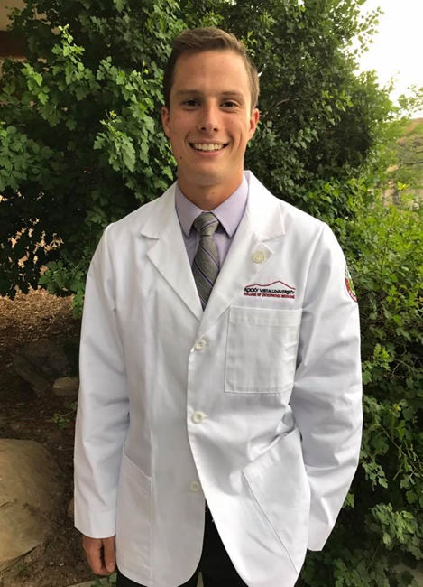
My “Babies”
Aleesa – TCA Graduate 2016
UCCS – Biochemistry
Lorne – TCA Graduate 2012
UCCS Graduate 2016
Pursuing Doctorate 2017

Slide 5
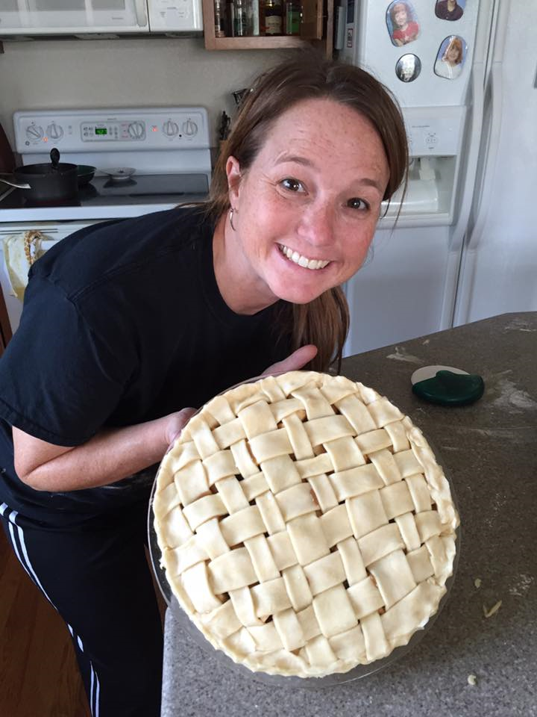
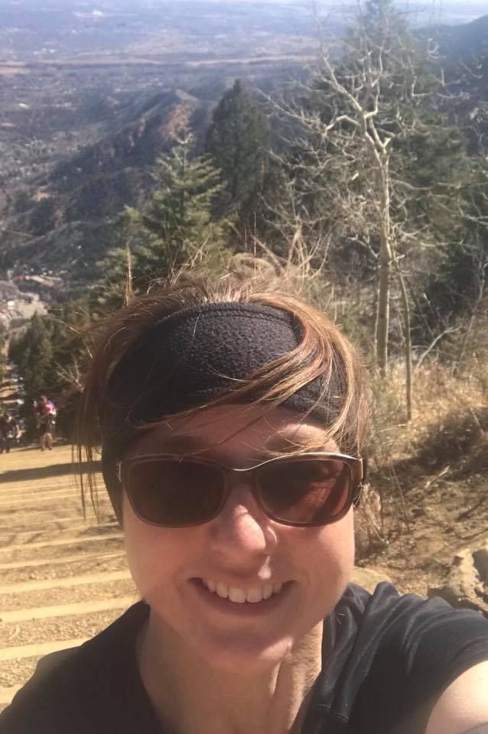
Passions
Family
Science
Teaching
Gardening
Traveling
Hiking/14ers
Cooking
Fitness
Soccer

Slide 6
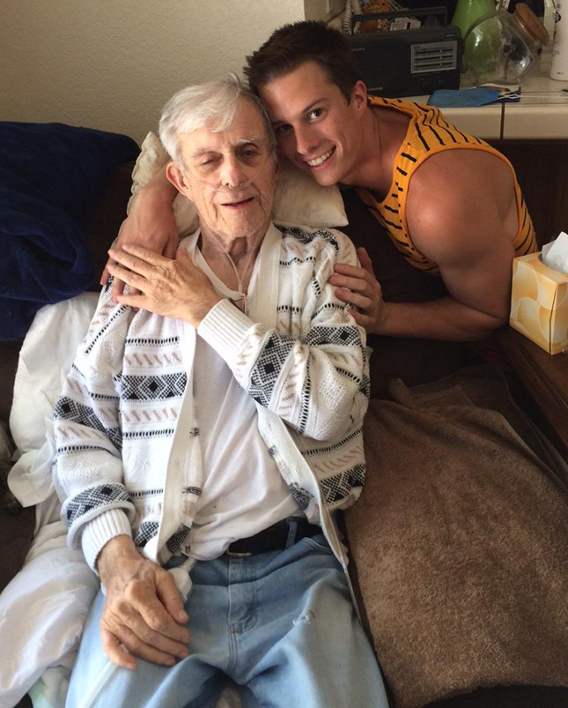
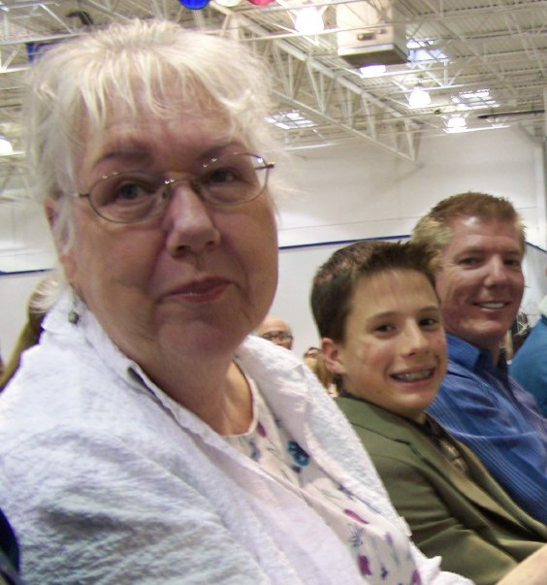
My Mom Roberta Stevens
August 28, 2009
My Father-In-Law Lewis Muir
Summer 2014
Notes:
This summer, I spent 3 weeks in California taking care of my father-in-law, Lewis, who has terminal lung cancer, and is currently under Advanced Hospice home care. I feared going because our relationship was somewhat fractured. I am not normally a praying gal – spiritual – but not religious, but I asked my hiking group before I left to pray for perseverance, patience, and a serving heart. And this summer - I was given a gift. It was unexpected. All of those life lessons – those moments of growth that focus on living with purpose …that I had accumulated over these last 8 years since my mother’s death were razor sharp for this moment in time. I focused on whole person… not only for Lewis, but for myself…

Slide 7
How is tCA different from a Traditional school?
Understanding the whole person
Mind
Body
Spirit
Building relationships
Valuing discussions - Socratic

Slide 8
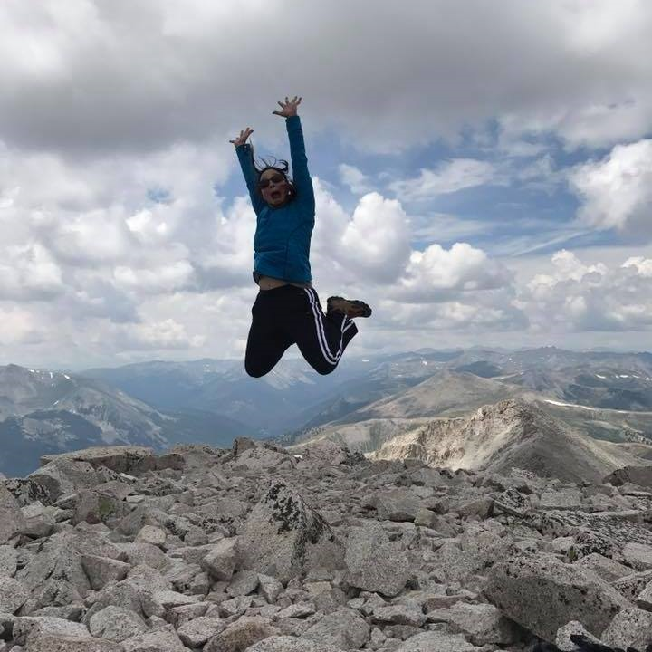
It’s going to be a GREAT year!
14er - Mt. Princeton - August 2017

